Slide 1


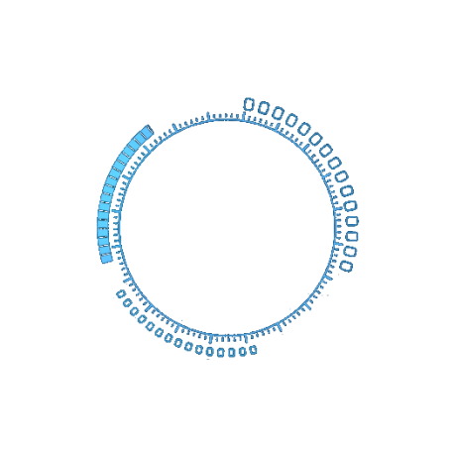
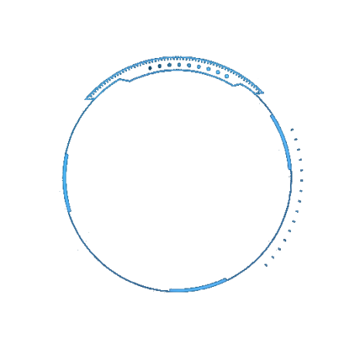
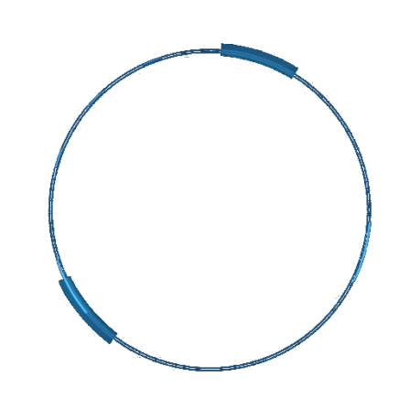
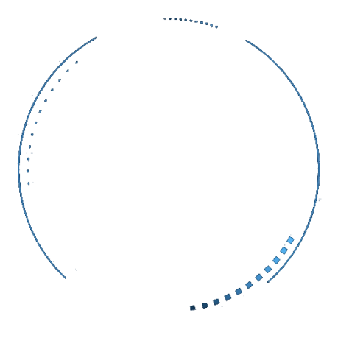
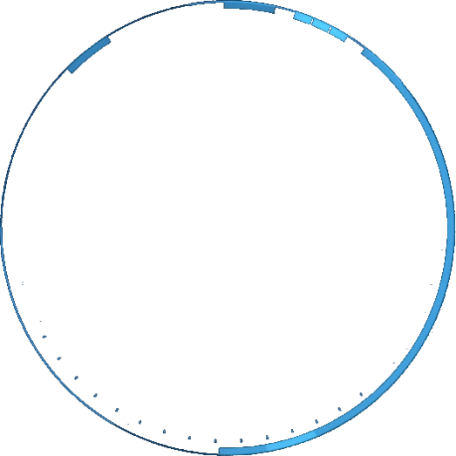


Blockchain
By
Dr Rajesh Kumar

Slide 2
Contents
1.Why we need Blockchain
2.What is Bitcoin and Blockchain?
3.How does Blockchain work?
4.Features of Blockchain
5.Who uses Blockchain?
6.What is Blockchain?
7.Use Case: Blockchains and Banks
8.Ethereum
9.Features of Ethereum

Slide 3
Contents
10.Cryptocurrency
11.Smart Contract
12.Ethereum Virtual Machine
13.Ethereum Virtual Machine- Gas
14.Applications of Ethereum
15.Why smart contract?
16.What is a smart contract?
17.Advantages of smart contract
18.Use case - Crowdfunding smart contract
19.What is Bitcoin
20.Advantages of Bitcoin
21.What is Blockchain?
22.Concepts of bitcoin Mining

Slide 5
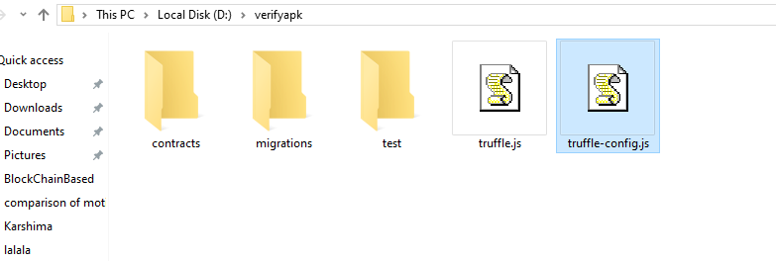
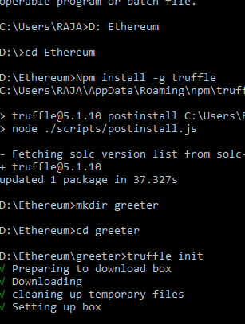
Setup Environment
Install node js
Install ganache
Create folder in D: Ethereum
Npm install –g truffle
Go to c:/users/xxxx/appdata/Roming/npm, rename truffle.cmd to truff.cmd
D:Ethereum Mkdir greeter
Cd greeter
Truffle init // initialize a new truffle project
We will start write smart contract greeter.sol
To deploy our newly created contract we need to add a file
2_deploy_contract.js file under migration folder. After creating this file add the following code to it
Inside our backend directory, open up truffle.js and add the following code
Infura IPFS Gateway

Slide 6
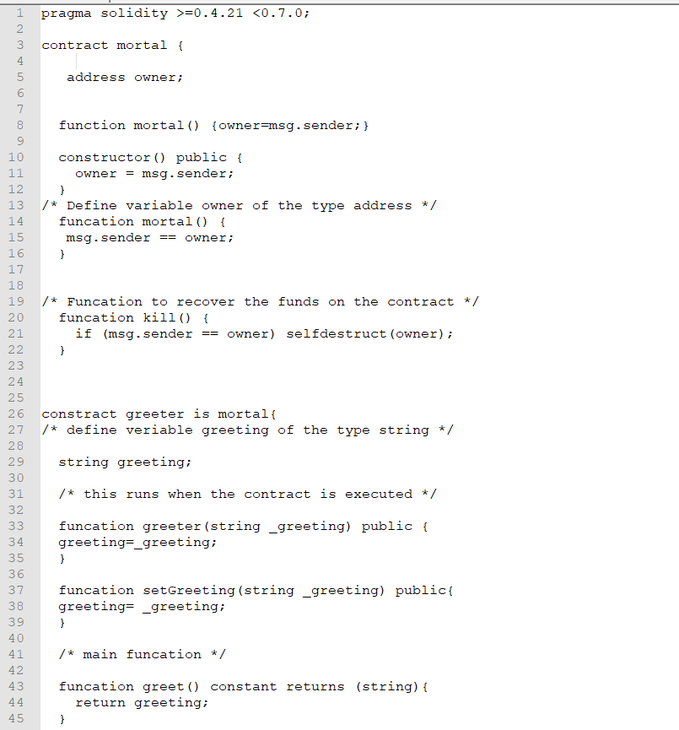
Greeter.sol

Slide 7
2_deploy_contract.js
var greeter = artifacts.require(“./greeter.sol”);
module.exports= funcation(deployer){
deployer.deploy.(greeter, ‘Hi Hello’),{gas:6700000});
}

Slide 8
Truffle.js
module.exports = {
networks: {
developments: {
host:"localhost",
port: 7545,
network_if:'*
}
}
};

Slide 9
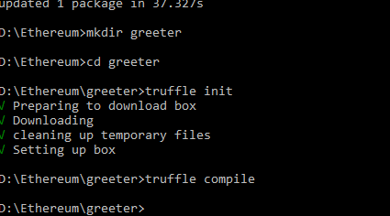
truffle compile
This will create a new folder called build. This build folder contains JSON objects that will be used to deploy our smart contracts. Finally run truffle migrate
truff compile
As we are connected and running our testrpc on the same port we will see our smart contract deployed successfully. Now that we have deployed our contract we can interact within the truffle console
truff migrate
Lets see where the contract was deployed
Truff console (to interact with my )

Slide 10
greeter.address
We will get the address where the contract was deployed in the network
greeter.at(greeter.address).greet()
Greeter.at(greeter.address).setGreeting(“change greet value”)
Greeter.at(greeder.address).greet()

Slide 11
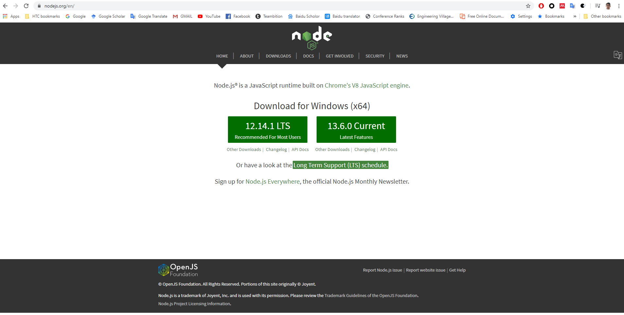
DEPENDENCIES
https://nodejs.org/en/

Slide 12
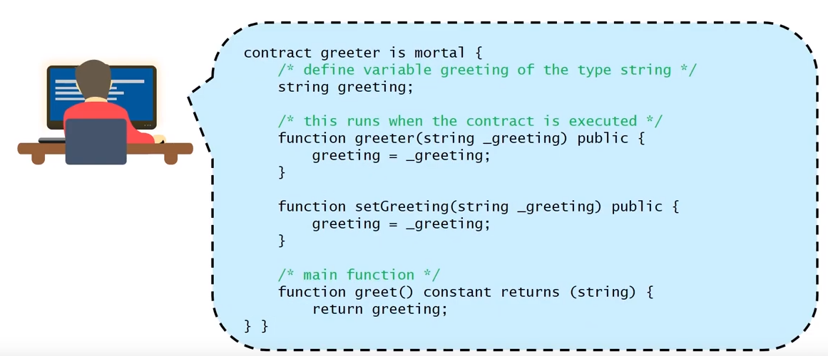
Requirements
Ganache (can be used to develop and deploy contracts)
Truffle installed (Testing Framework)

Slide 13
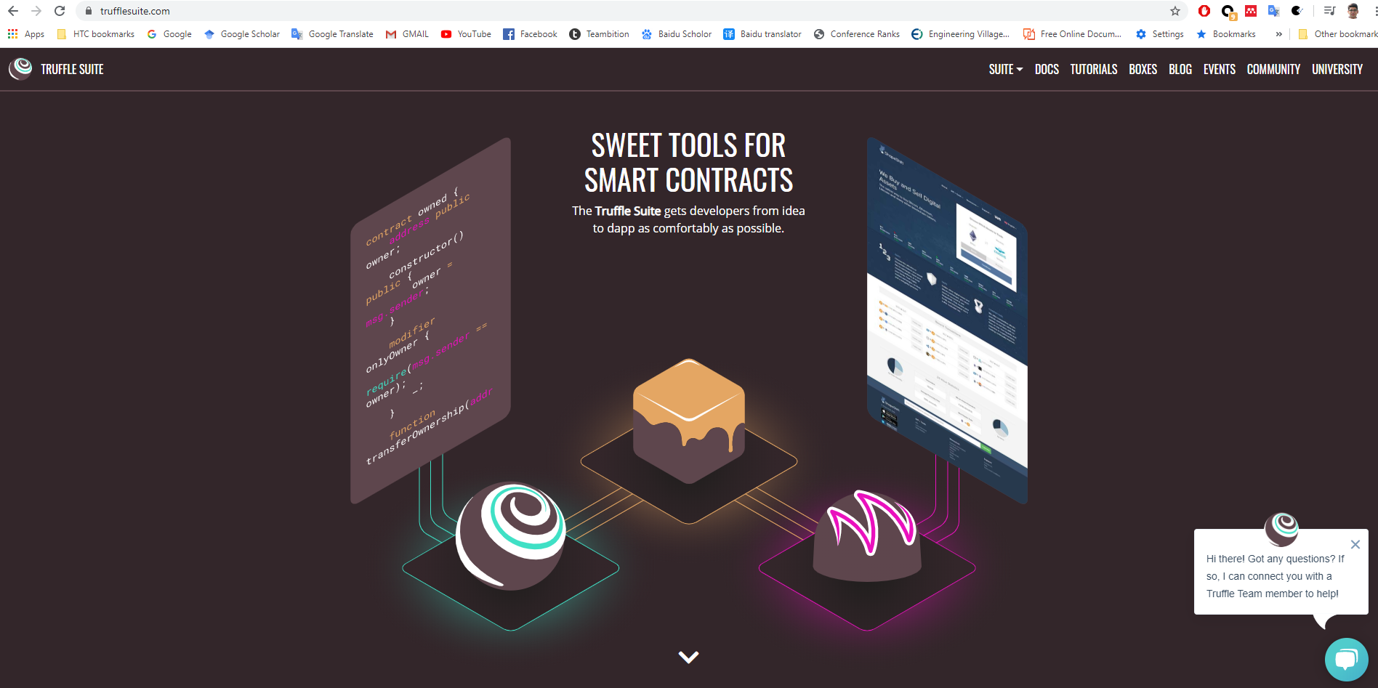
https://www.trufflesuite.com/ganache

Slide 14
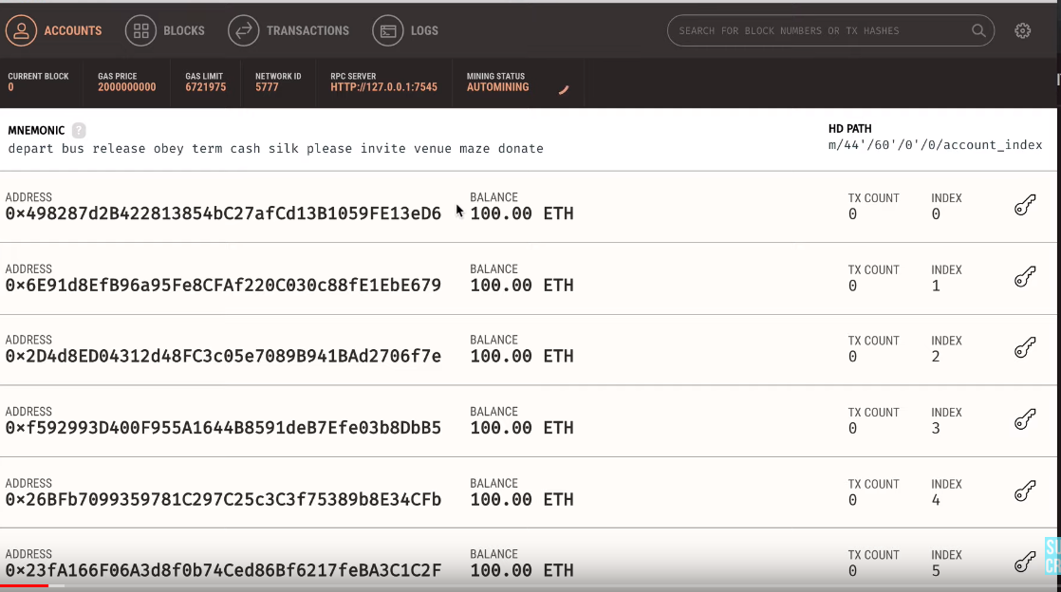
Ganache
Public blockchain
Use for smart contract
Test smart contract
Personal blockchain network

Slide 15
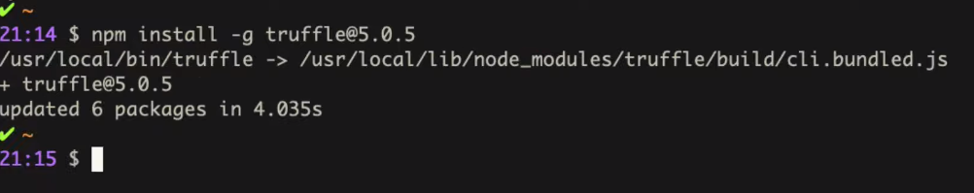
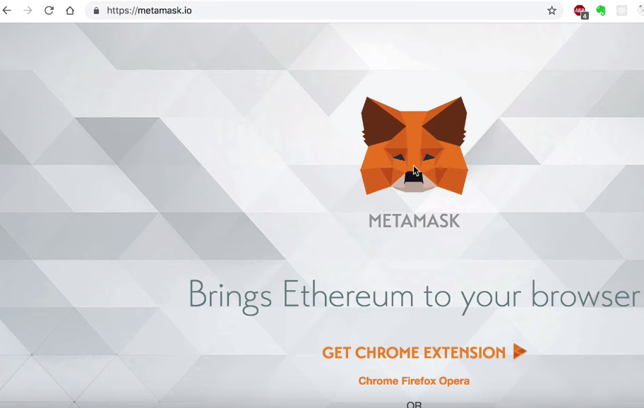
Install MetaMask in browser We need special browser for smart contract

Slide 16
Create a Project
Download Project Code from GitHub.
Smart Contract Demo download:
https://github.com/raja21068/IPFS-Smart-Contract-Upload-Register-Files-Dapps
https://github.com/raja21068/Smart-Contract-Blockchain

Slide 17
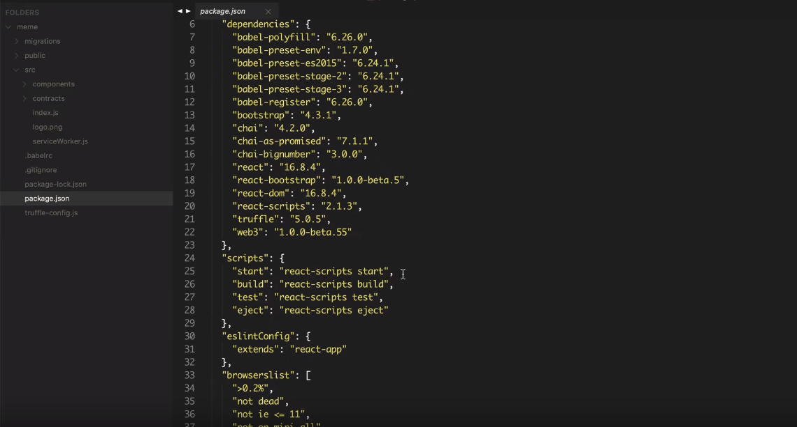
Install these packages

Slide 18
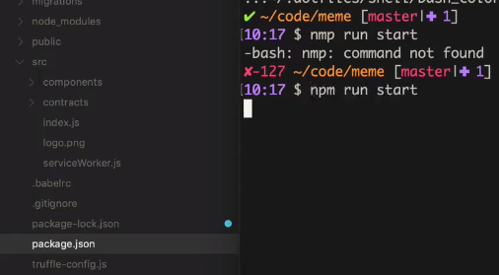
Start Local Server

Slide 19
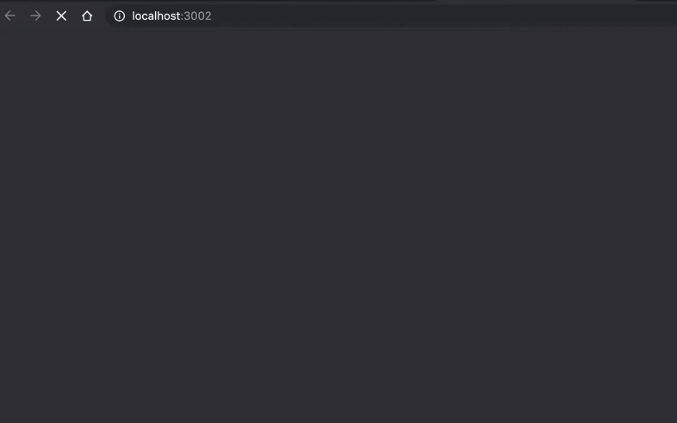
Check Your Web Browser

Slide 21
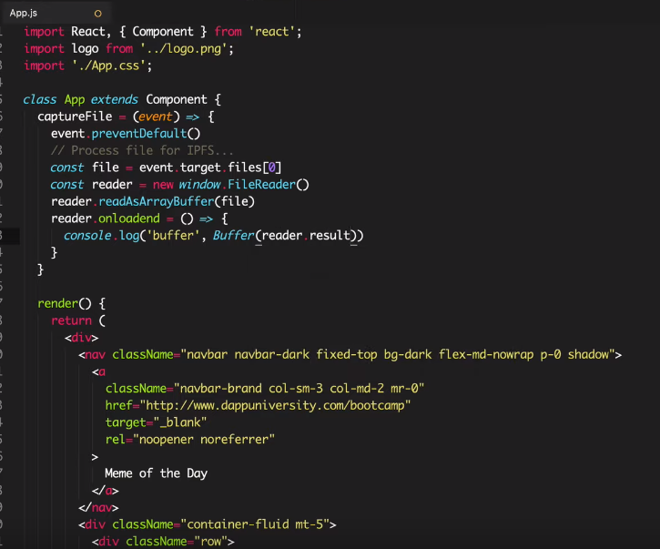

Slide 22
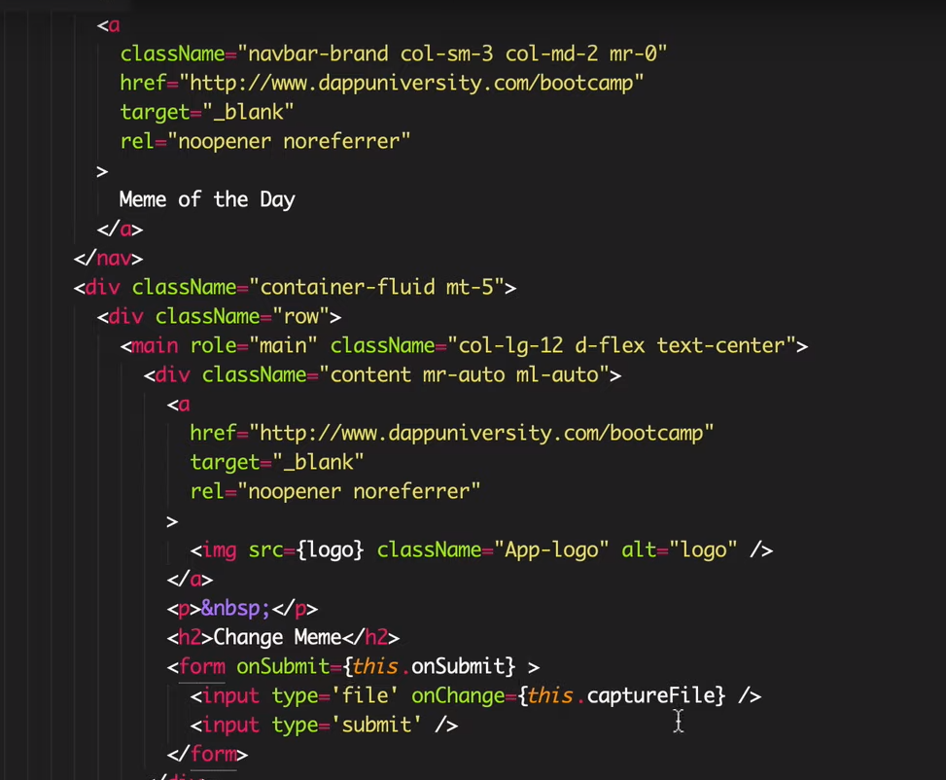

Slide 23
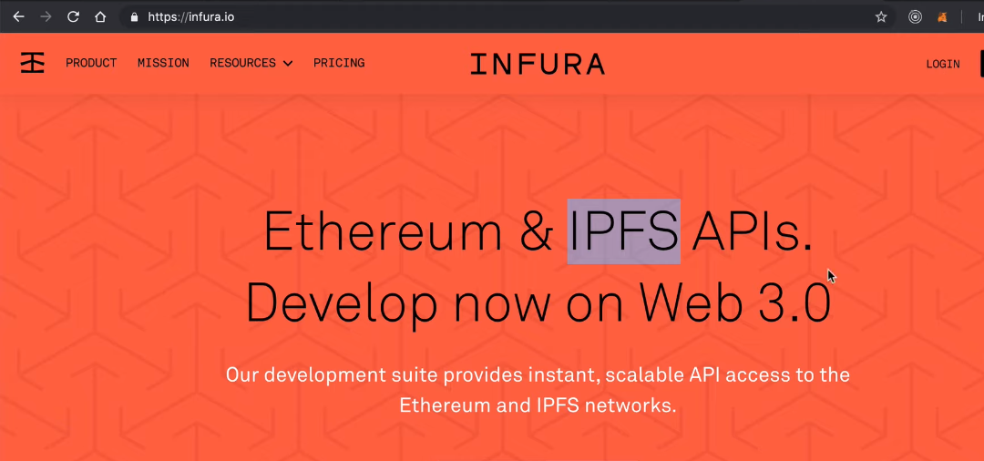
Platform Infura IPFS Gateway Free

Slide 24
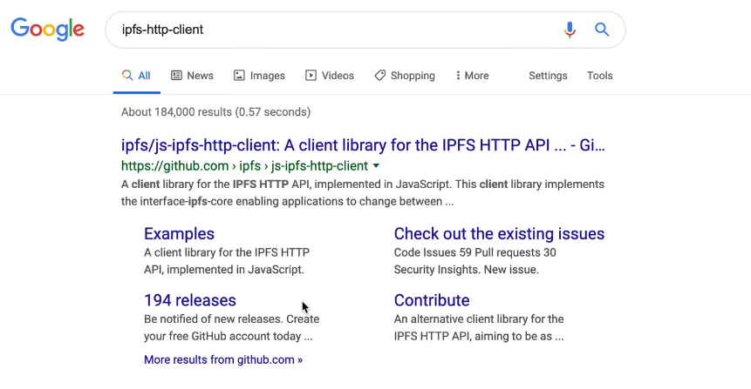
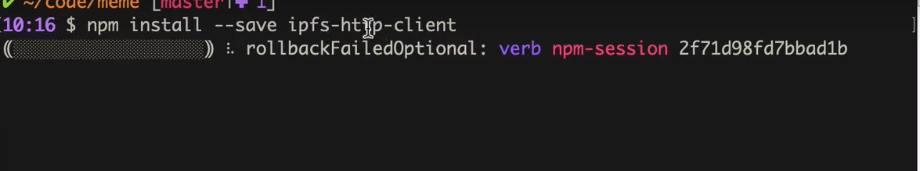
Install IPFS Http Client (www.npmjs.com/packadages/ipfs-http-client)

Slide 25
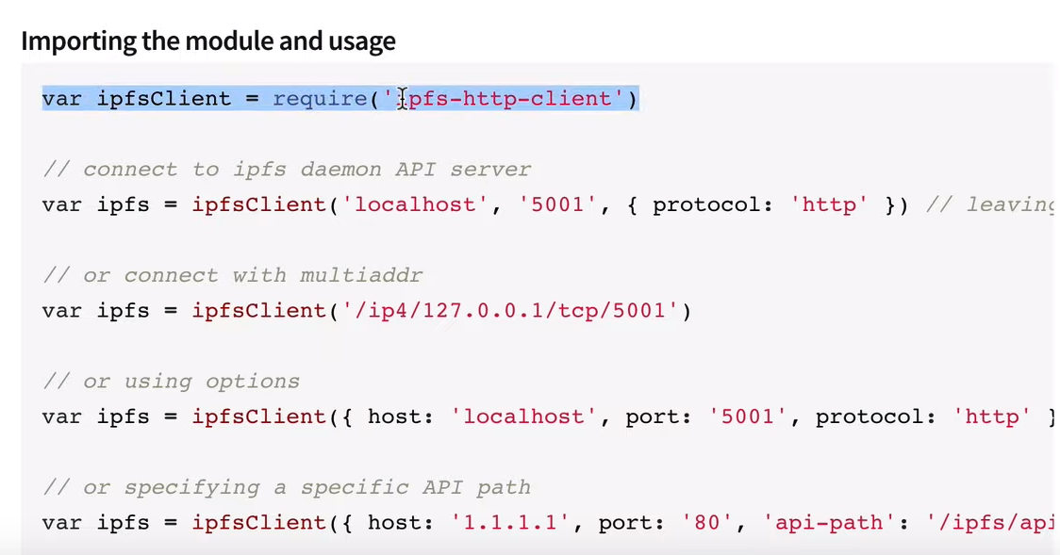

Slide 26
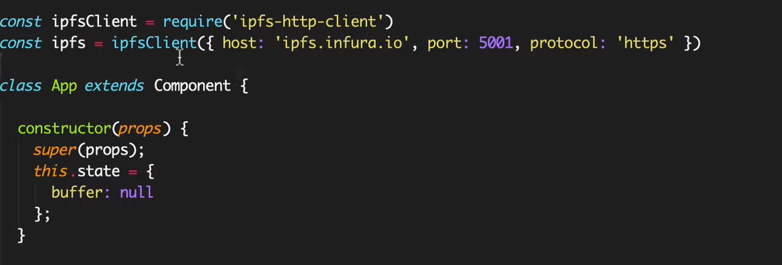

Slide 27
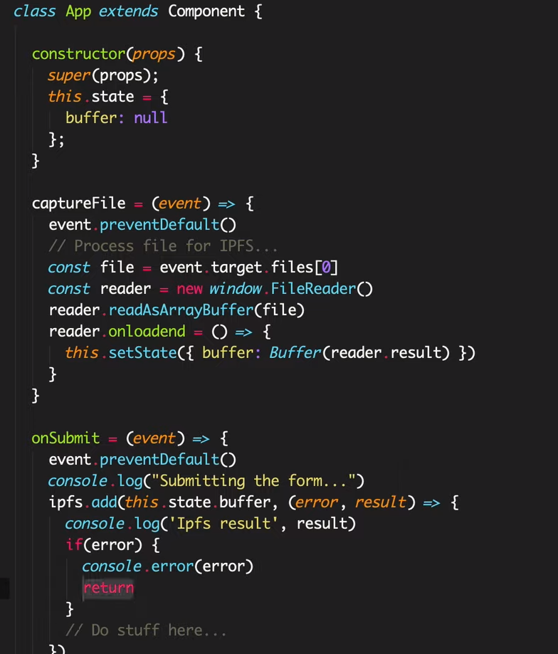

Slide 28
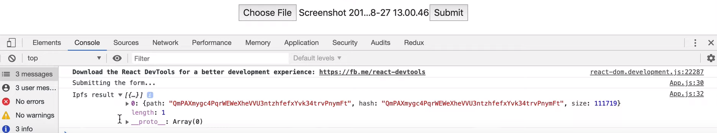
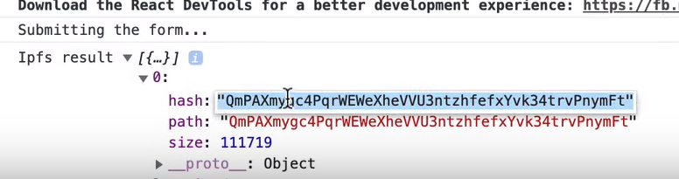
Upload File Again

Slide 29
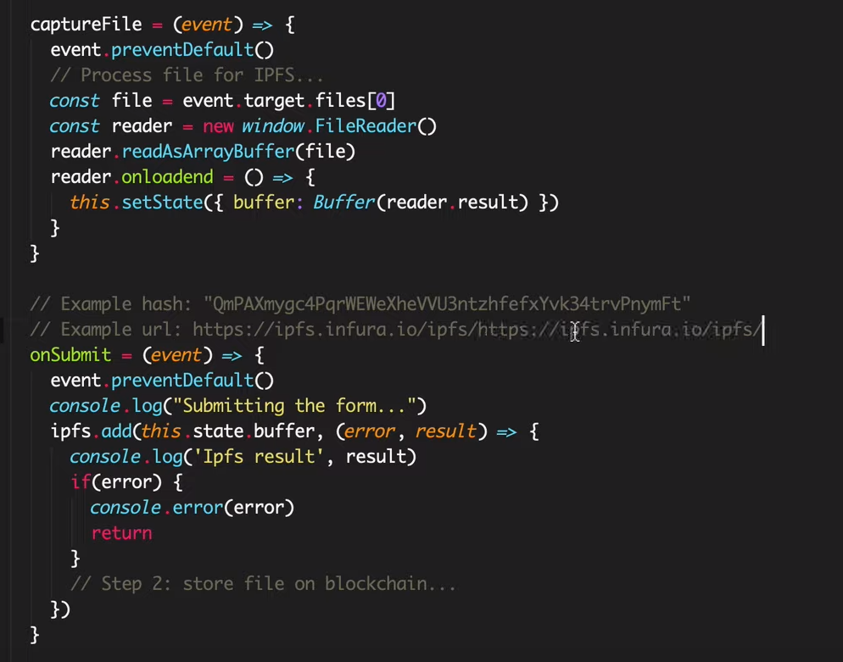
Step 2: Store File into the Block Chain

Slide 30
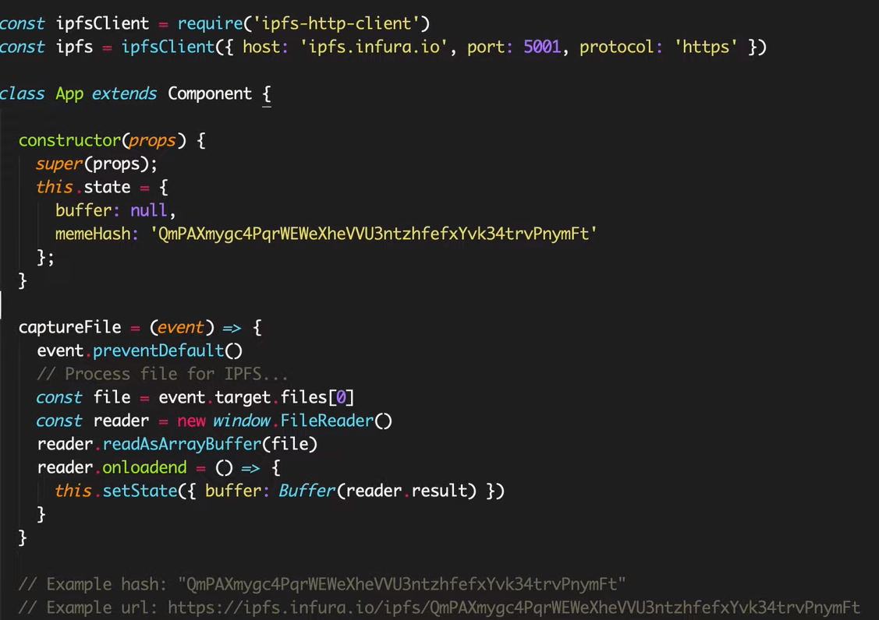

Slide 31
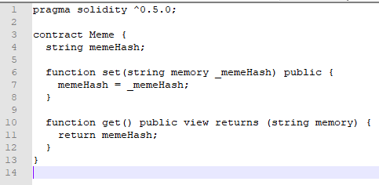
Create a Ethereum smart contract

Slide 32
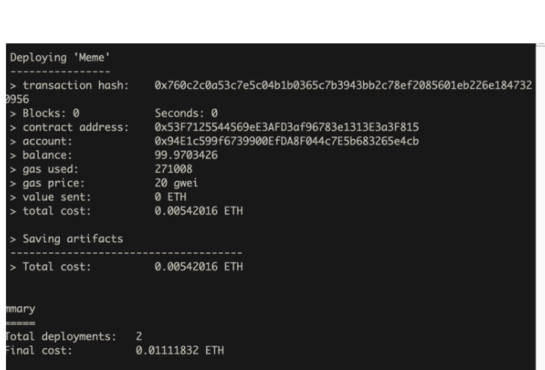

Slide 33
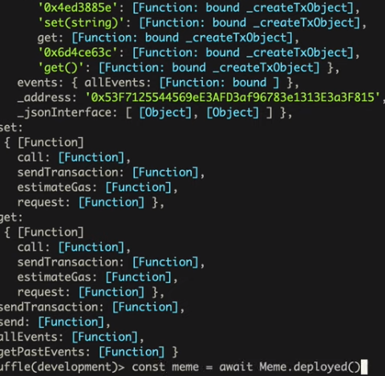

Slide 34
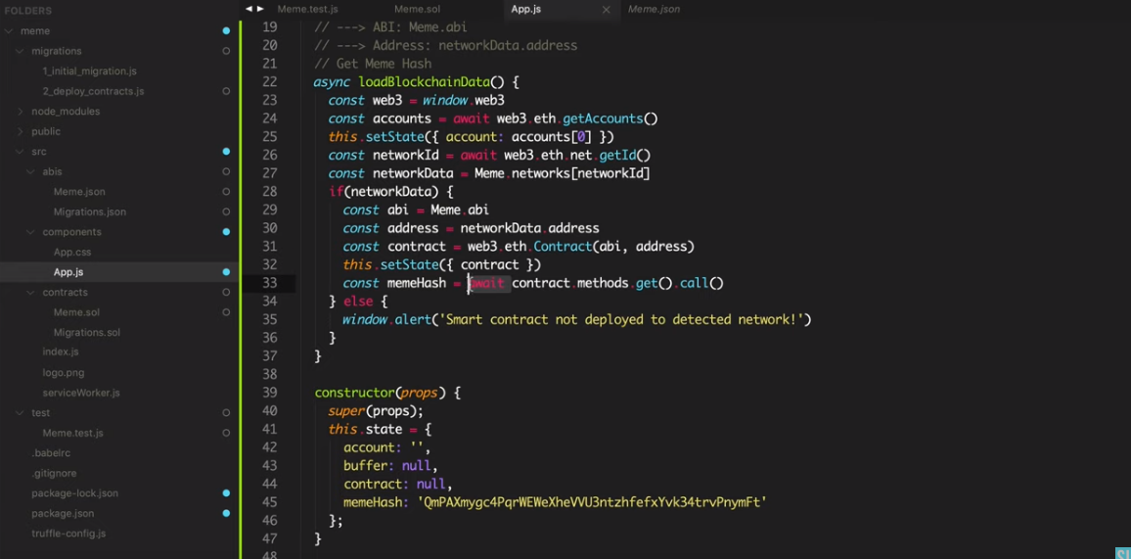
WEB3

Slide 35
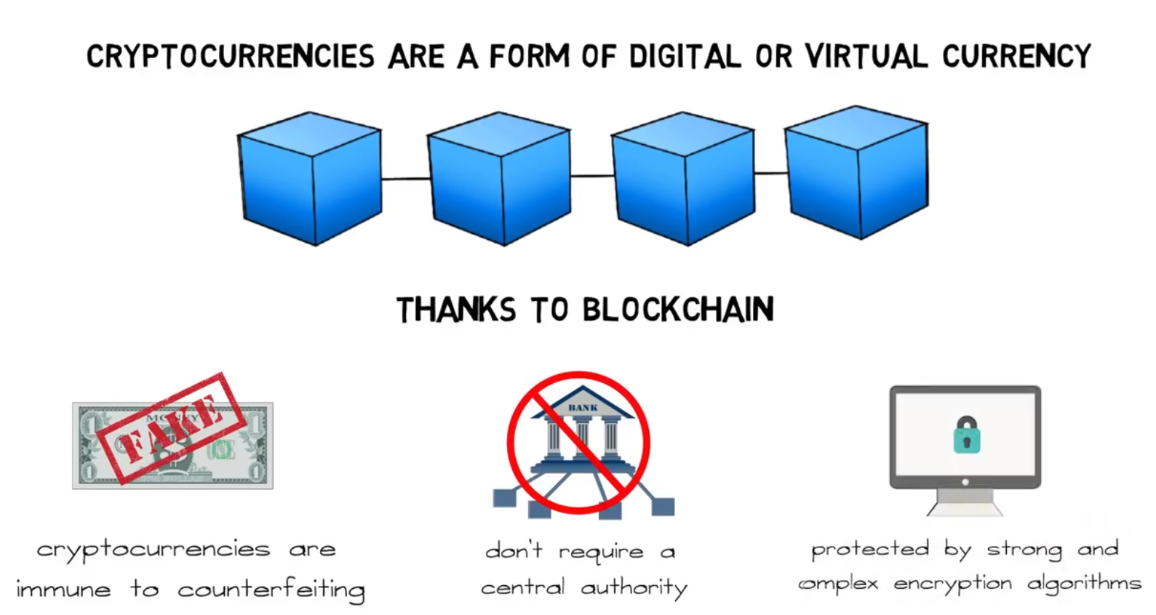
Blockchain

Slide 36
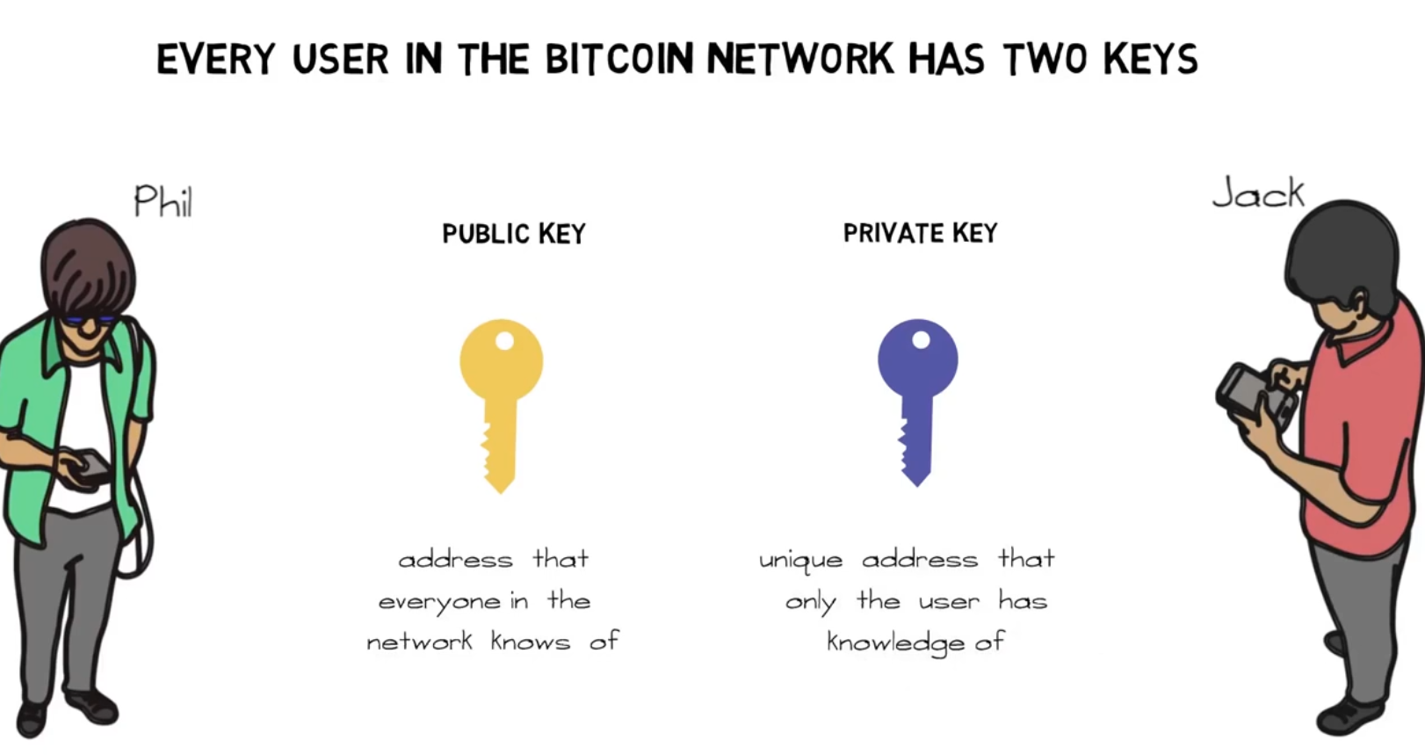

Slide 37
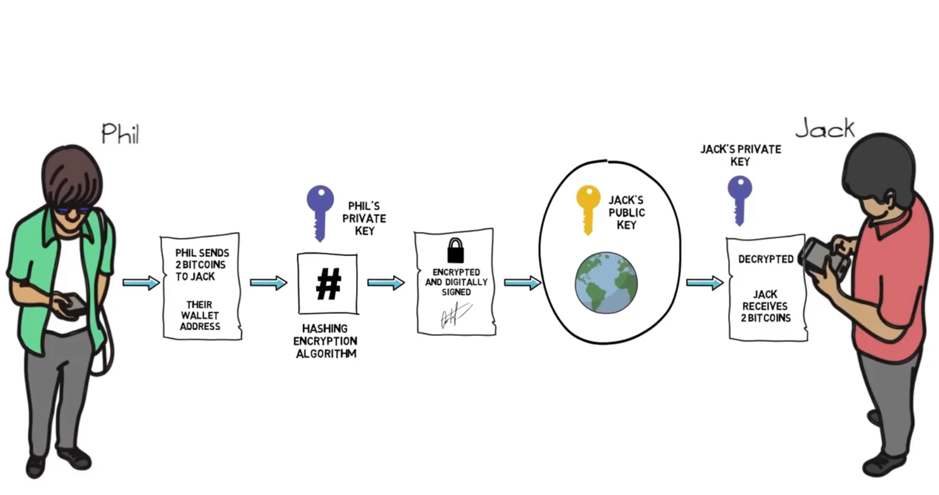

Slide 38
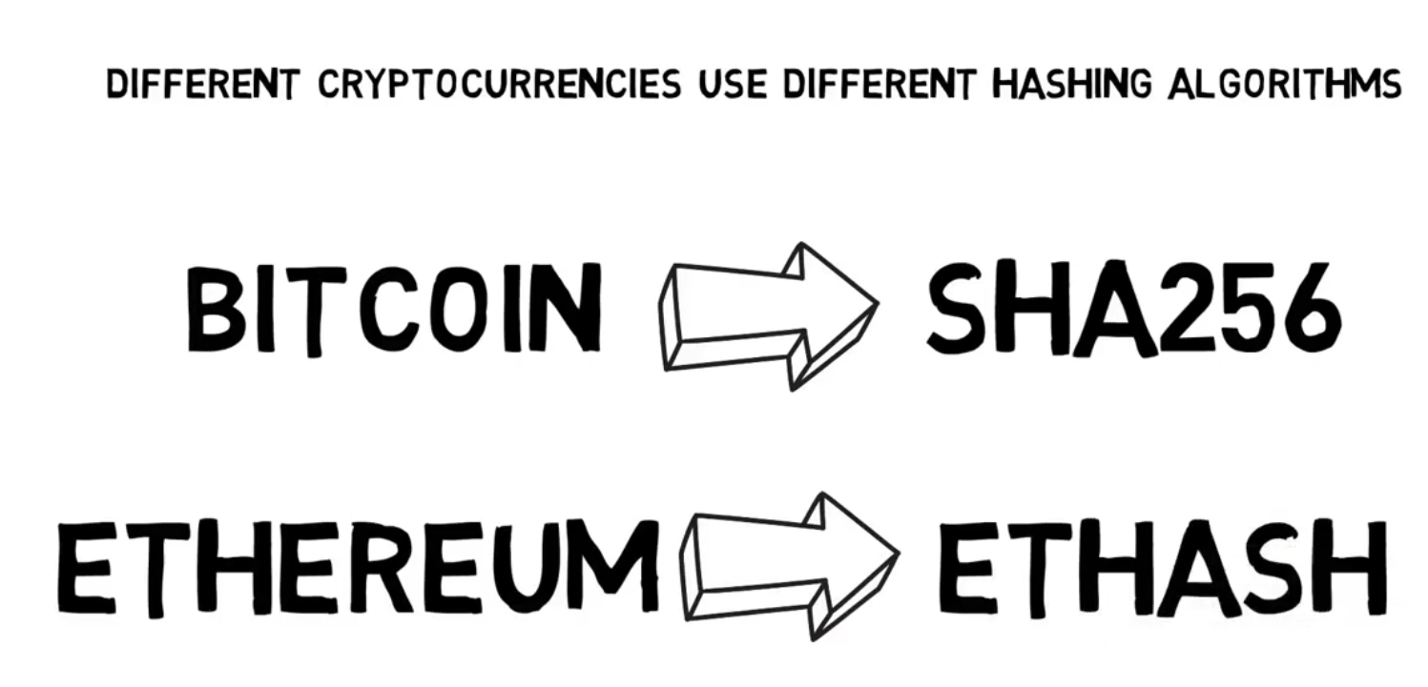

Slide 39
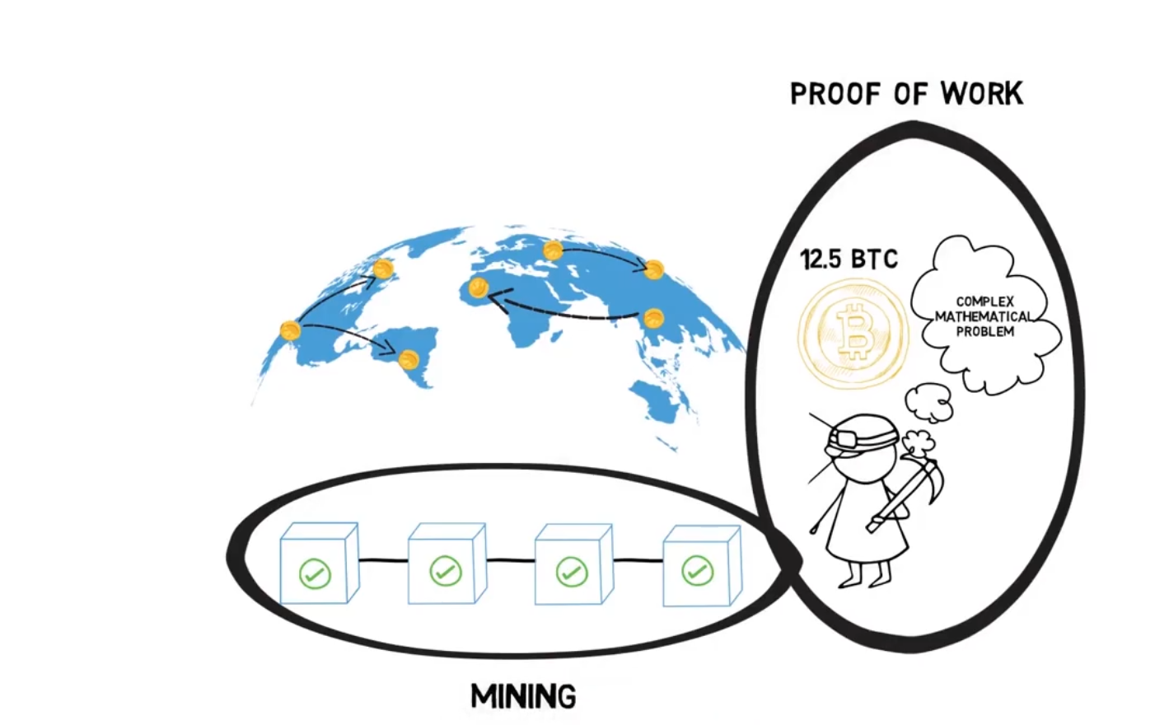
Miners
Miners Add to block into the blockchain
The process of solving the complex mathematical problem is called Proof of Work
The Process of adding a block is called Mining

Slide 40
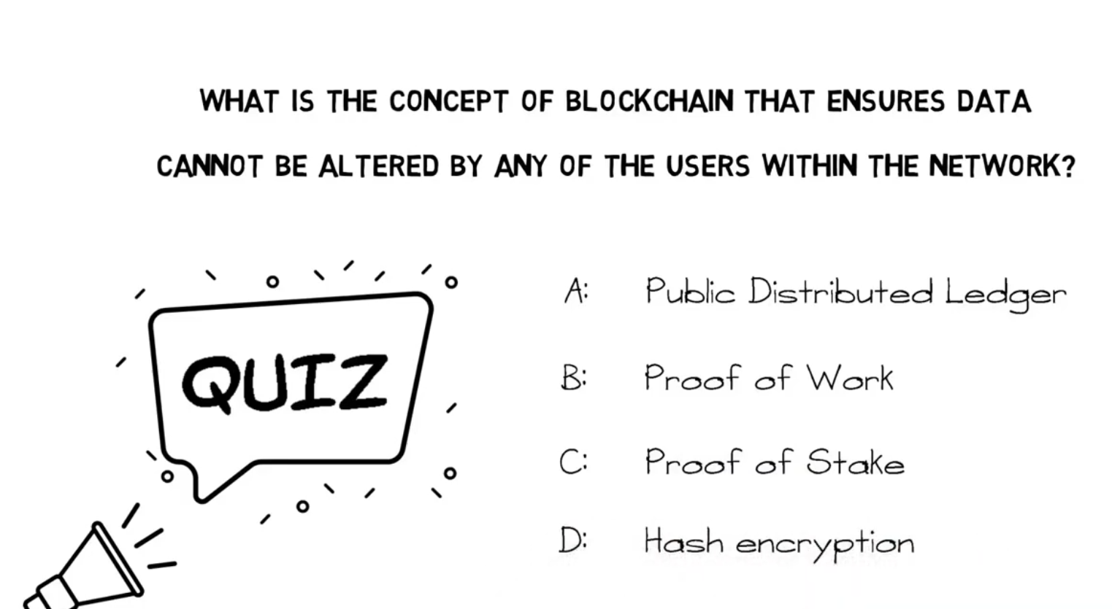

Slide 41
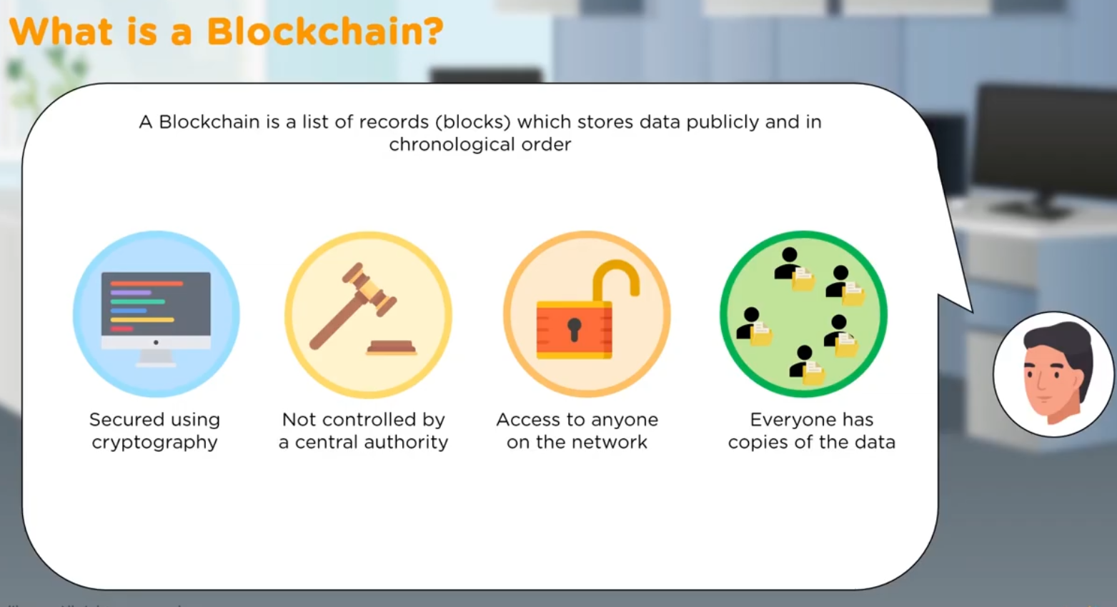

Slide 42
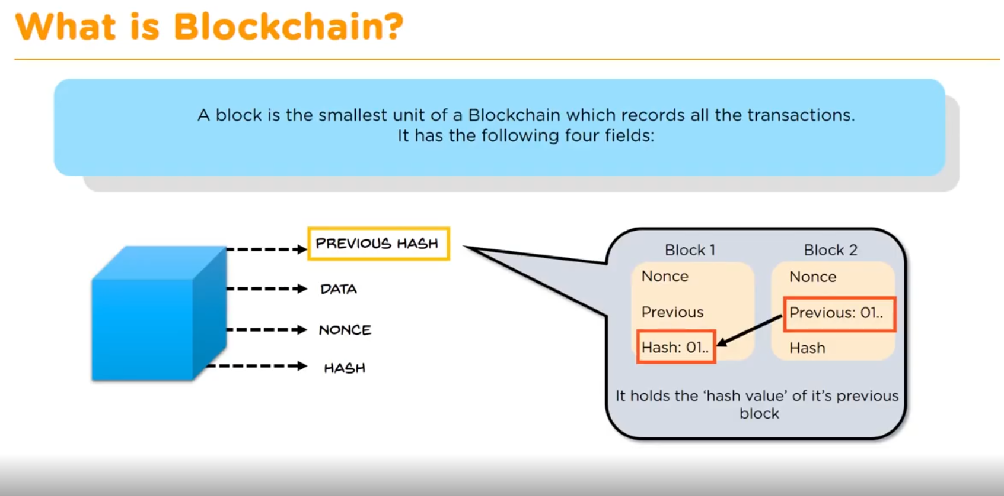

Slide 43
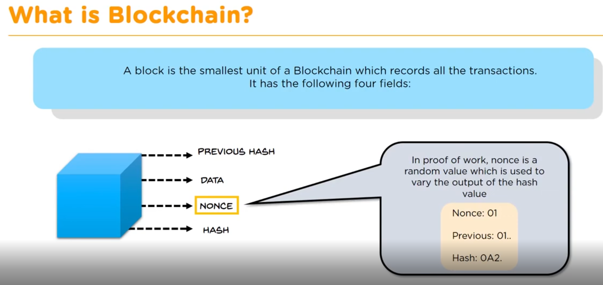

Slide 44
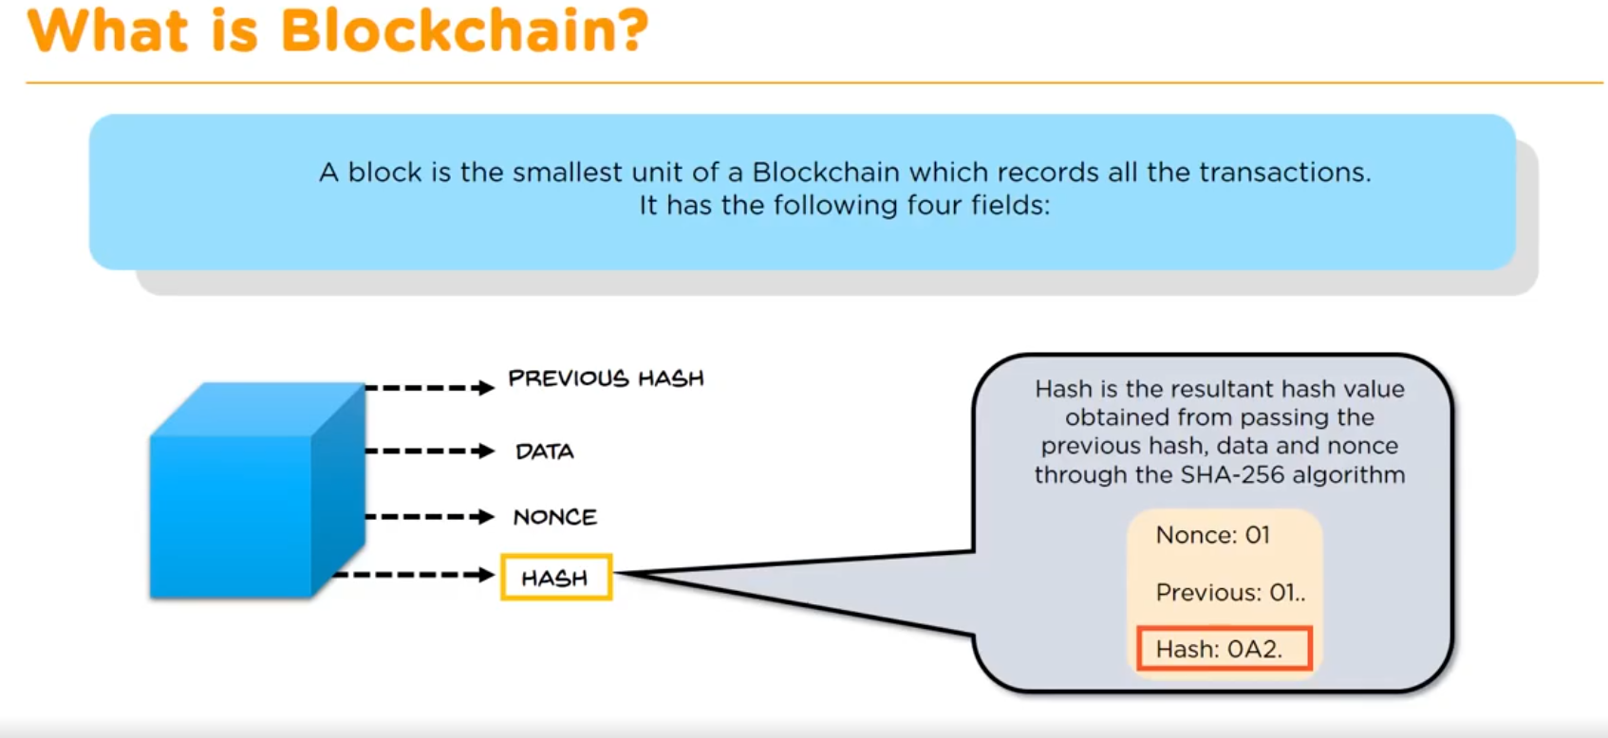

Slide 45
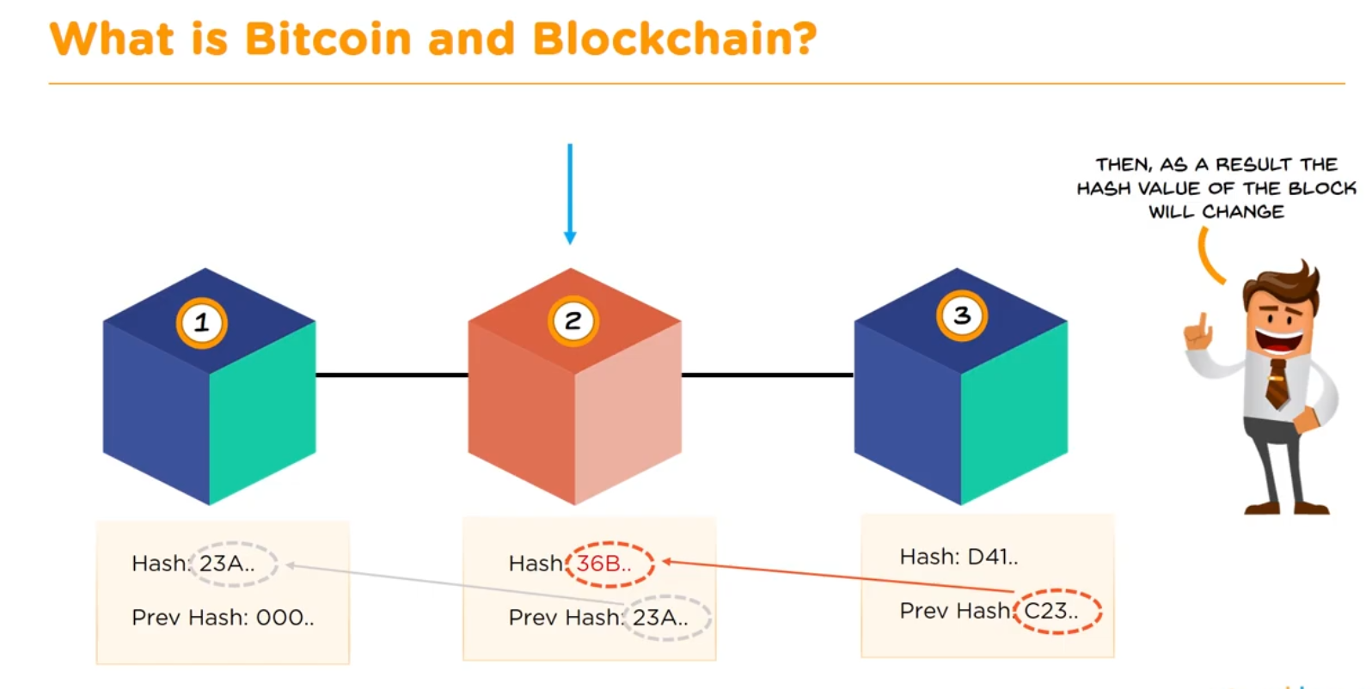

Slide 46
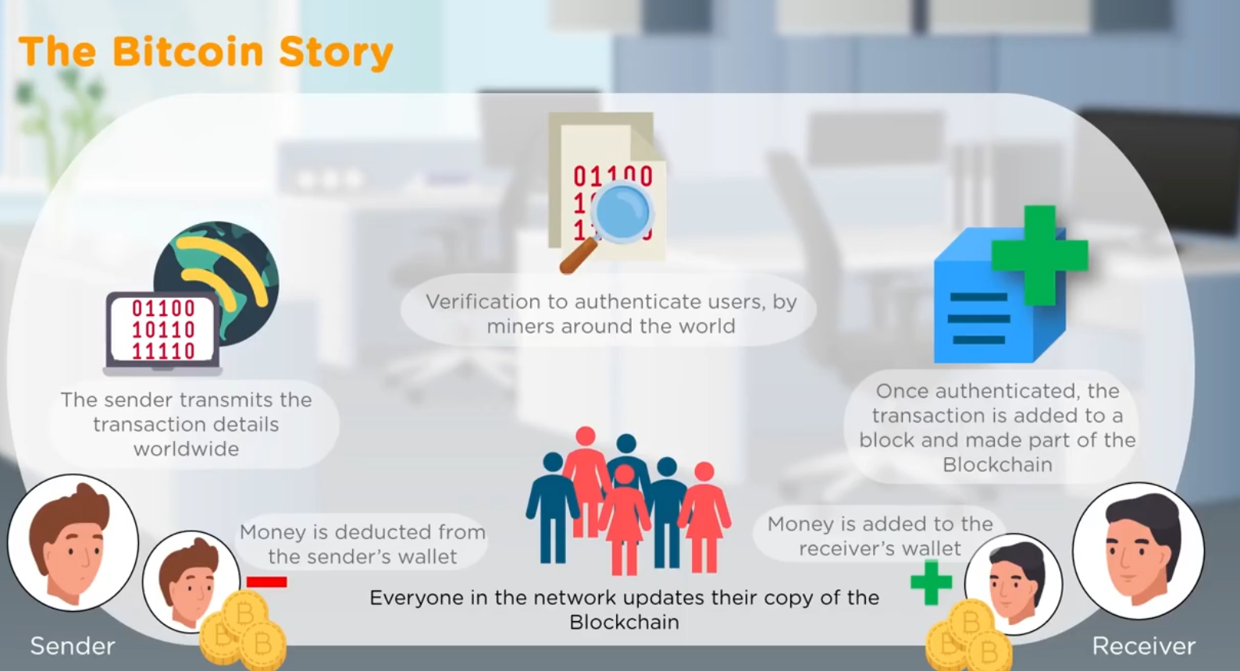

Slide 47
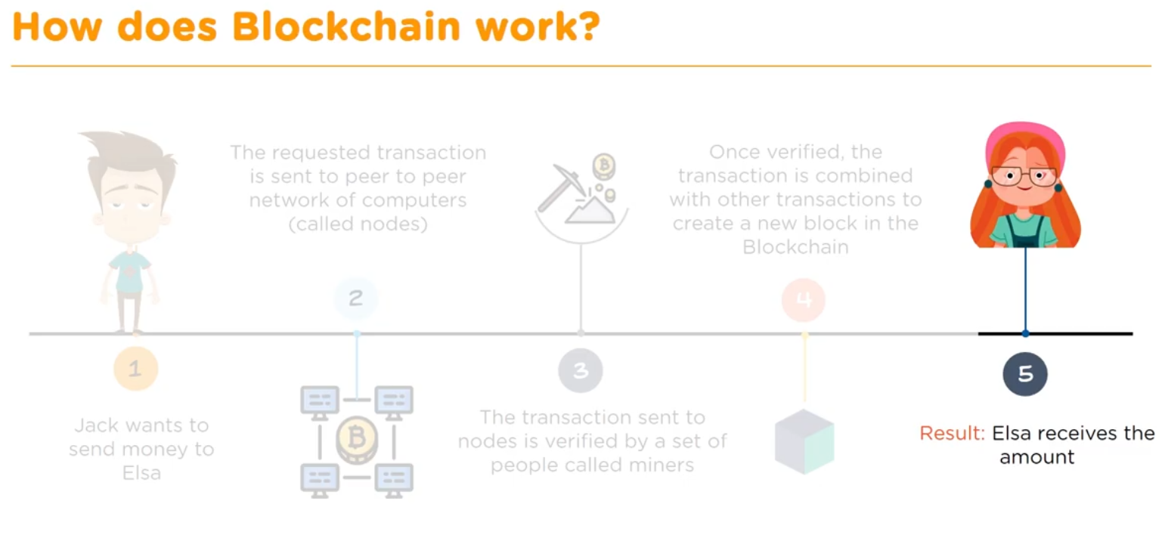

Slide 48
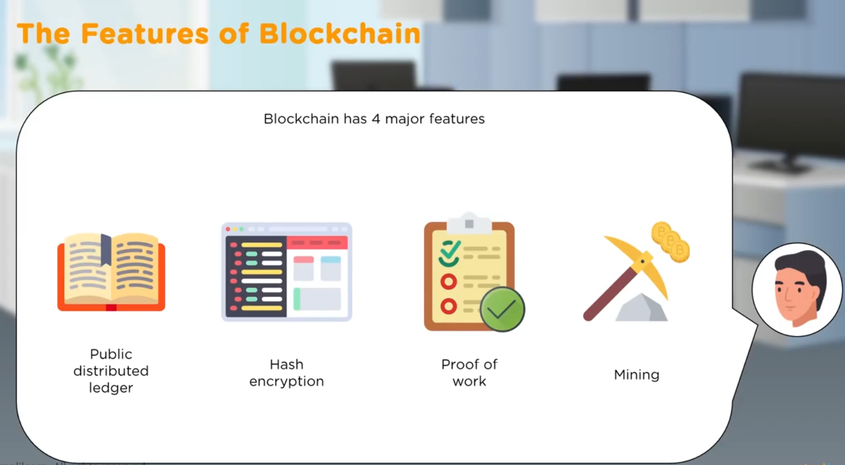

Slide 49
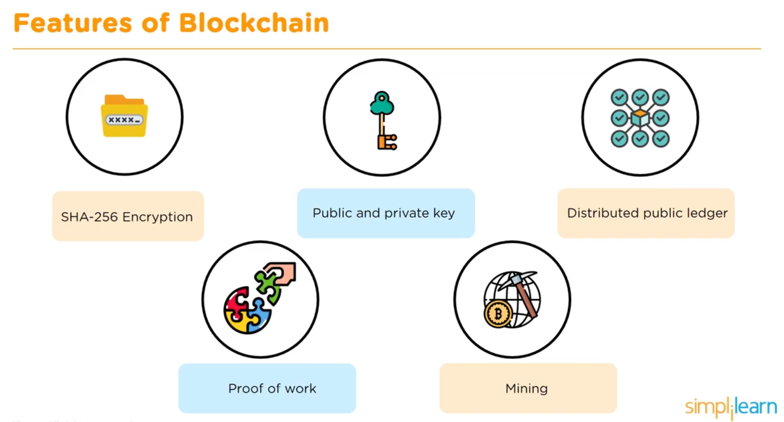

Slide 50
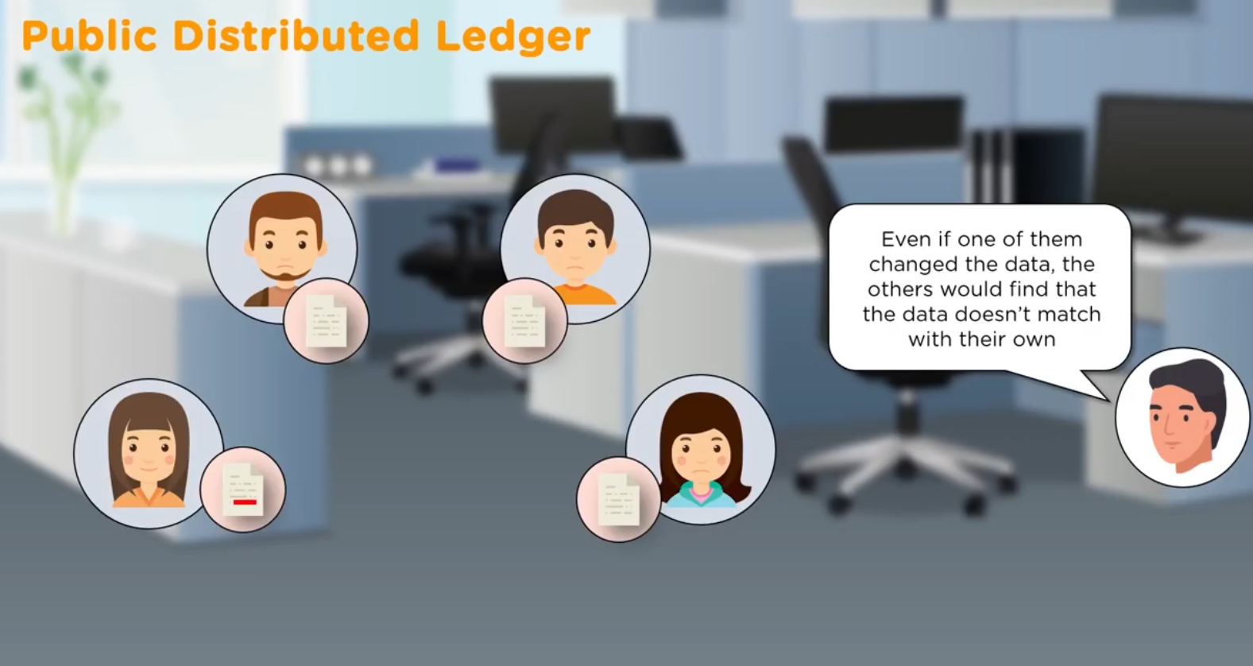

Slide 51


Slide 52


Slide 53


Slide 54


Slide 55


Slide 56


Slide 57


Slide 58


Slide 59


Slide 60


Slide 61


Slide 62


Slide 63


Slide 64


Slide 65


Slide 66


Slide 67


Slide 68


Slide 69


Slide 70


Slide 71

Results share in the network

Slide 72


Slide 73


Slide 74


Slide 75


Slide 76


Slide 77


Slide 78


Slide 79


Slide 80


Slide 81


Slide 82


Slide 83


Slide 84


Slide 85


Slide 86


Slide 87


Slide 88


Slide 89


Slide 90


Slide 91
If some one in a Blockchain wanted to input wrong data by spreading the wrong information around..
Would he be able to get away with it?
That’s why we had Byzantine Fault Tolerance conceses algorithm

Slide 92


Slide 93



Slide 94


Slide 95


Slide 96


Slide 97


Slide 98

Add the block at the same time

Slide 99


Slide 100


Slide 101


Slide 102


Slide 103


Slide 104


Slide 105


Slide 106


Slide 107


Slide 108


Slide 109


Slide 110


Slide 111


Slide 112


Slide 113


Slide 114


Slide 115


Slide 116

Crypto Currencies

Slide 117


Slide 118


Slide 119


Slide 120


Slide 121


Slide 122


Slide 123


Slide 124


Slide 125


Slide 126


Slide 127


Slide 128


Slide 129


Slide 130


Slide 131


Slide 132


Slide 133


Slide 134
It is used to pay for the computational resources and transaction fees on the Ethereum network
Like Bitcoin peer to peer currency
Apart from paying for transaction, Either is also used to buy gas, which is used to pay computation
Either can be utilized for building decentralized applications, smart contract and making standard peer to peer payments

Slide 135


Slide 136

Smart Contract

Slide 137


Slide 138


Slide 139


Slide 140


Slide 141


Slide 142


Slide 143


Ethereum Virtual Machine
Run time environment for Ethereum smart contracts
EVM understand solidity language
Test your smart contract

Slide 144

How EVM Work

Slide 145


Slide 146


Slide 147


Slide 148


Slide 149


Slide 150


Slide 151


Slide 152


Slide 153


Slide 154


Slide 155


Slide 156



Slide 157


